Slide 1
Application of Operation Research for optimizing a Logistics Operation

Slide 2
Companies that apply Operation Research
HP,
IBM,
Chevron,
Disney, etc.
P&G,
GE,
UPS,
Coca Cola,
etc, etc

Slide 3
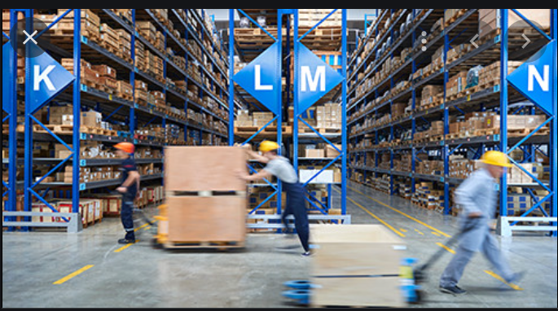
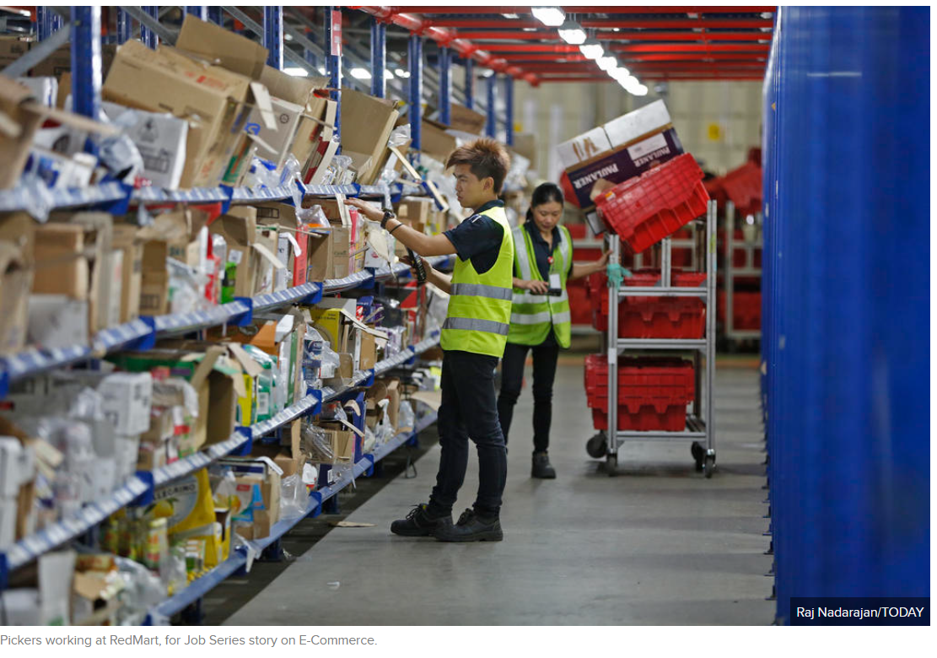
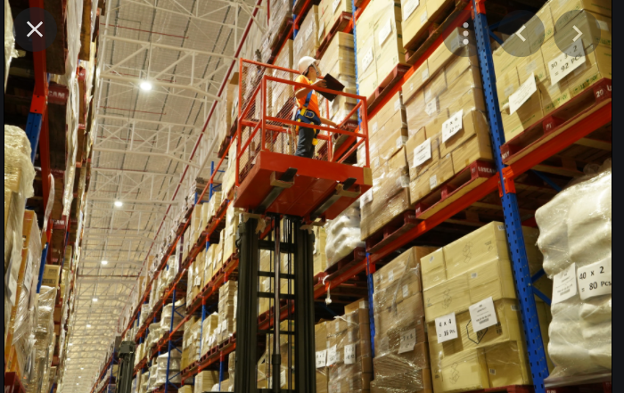

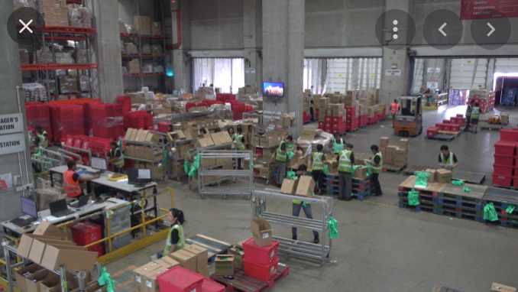
Conventional warehouse : labor intensive operation offers opportunity for optimization

Slide 4
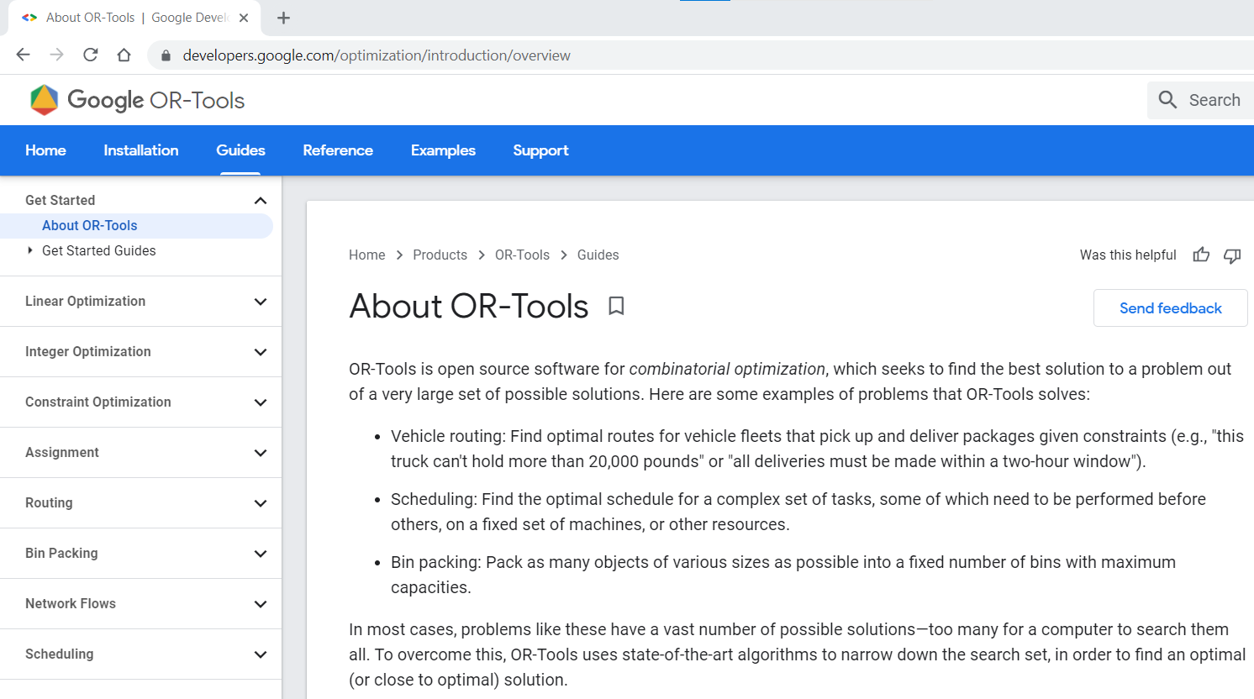

Open Source : Google OR-Tools

Slide 5
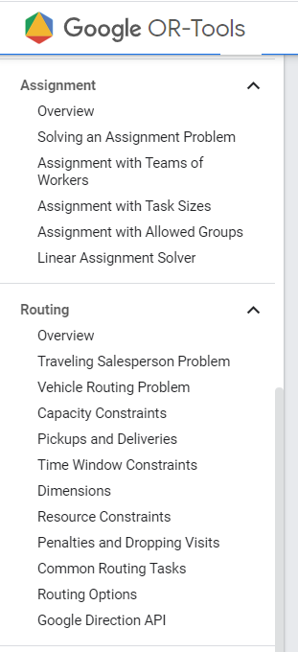
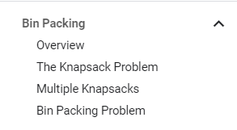
Example of optimization solver application in a typical logistics operation:
Assignment problem:
assigning tasks (SKU picking) to workers with objective to minimize total manhours to complete all tasks.
Travelling Salesman problem:
Determine the shortest route (travelling time) to travel to storage locations within warehouse to pick an order list of SKUs.
Vehicle Routing problem:
Find optimal routes for multiple vehicles visiting a set of locations to deliver (or pickup) goods.
With consideration of constraints of vehicle capacities, or
With consideration of constraints of delivery time window;
Bin Packing problem:
- Maximize the loading in each vehicle so as to deploy minimum number of vehicles to complete all deliveries.

Slide 6
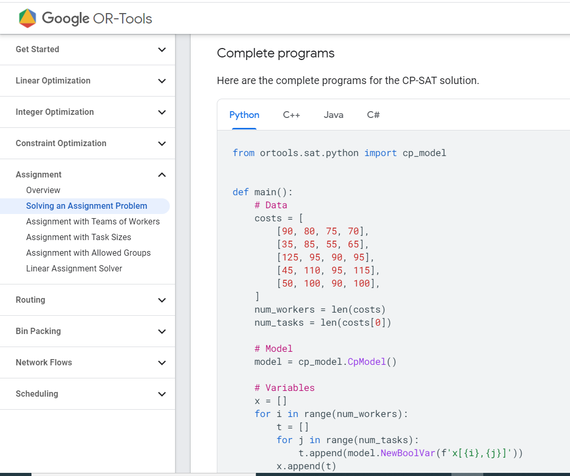
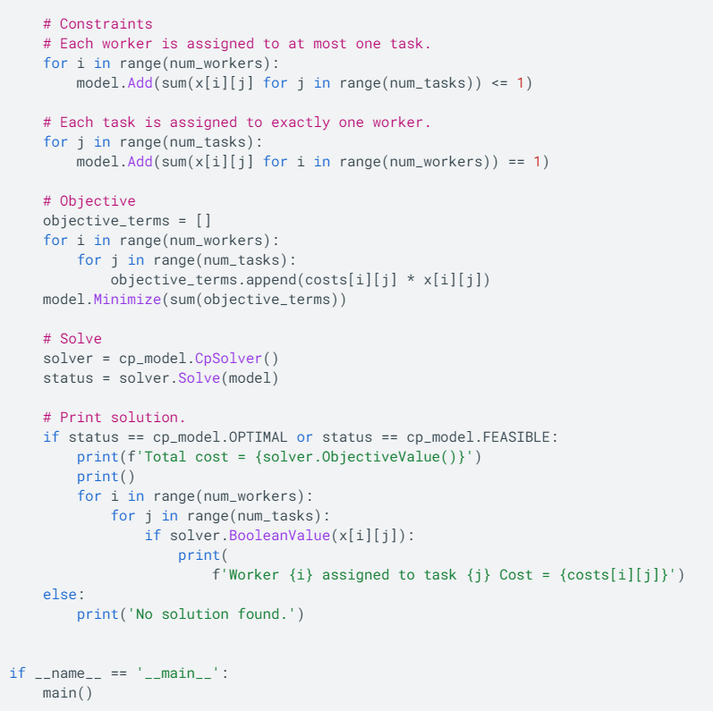
Solving optimization problems in Python, Examples.

Slide 7

ASSIGNMENT OPTIMISATION: Here, the SKU picking is modelled as an Assignment problem.
Orders arrive base on Poisson Distribution
Each batch of orders are sorted according to the SKUs.
Base on historical data, a worker takes x mins to pick an SKU. Time taken varies from worker to worker.
SKU A x 2
SKU A x 2
Order 1
SKU B x 3
SKU B x 3
Order 1
SKU C x 1
Sorted by SKU for picking assignment
SKU C x 1
SKU A x 5
High productivity
Order 2
SKU E x 4
SKU E x 4
SKU B x 4
Order 2
SKU F x 2
SKU C x 6
SKU F x 2
SKU A x 3
Medium productivity
SKU A x 3
SKU D x 5
Order 3
SKU C x 5
SKU C x 5
Order 3
SKU E x 6
SKU E x 2
Low productivity
SKU E x 2
SKU F x 7
SKU B x 1
SKU B x 1
SKU G x 2
Order 4
Order 4
SKU D x 5
SKU D x 5
SKU F x 4
SKU F x 4
Order 5
SKU F x 1
Objective : assign tasks in order to minimize total time taken to pick all SKUs.
SKU F x 1
Order 5
SKU G x 2
SKU G x 2

Slide 8
So, if “worker-vs-task” assignment problem is modelled this way, then data for model would be:
worker id
sku_id
quantities of the sku_id picked (to determine how this drives picking time)
time_stamp of each activity (to determine total time per picking cycle)
1. Picking order initiated
2. Worker acknowledge picking order
3. Worker proceed to picking
4. Worker place the SKU into respective order bins
5. Worker closes the picking order, proceed to next picking task
.. In order to derive a “worker-task-time” matrix, as in below example.
Task cycle time
Remarks:
Assignment problem can also be modelled in other ways feasible to calculate optimized solution.

Slide 9
Another way of modelling the Optimization problem (TRAVELLING SALESMAN) :
Here, the SKU picking is modelled as a Travelling Salesman problem.
Assume this is a large warehouse, time taken to move around is significant, and we want to minimize it.
Orders arrive base on Poisson Distribution
SKU A x 2
Average travelling time between SKU locations shall be used by algorithm to calculate optimal route (lowest time taken).
SKU B x 3
Order 1
SKU C x 1
SKU A x 2 @Loc A
SKU E x 4
SKU B x 3 @Loc B
Order 2
SKU C x 1 @Loc C
SKU F x 2
SKU A x 3
SKU C x 5
SKU E x 4 @Loc E
Order 3
SKU F x 2 @Loc F
SKU E x 2
SKU B x 1
Order 4
SKU A x 3 @Loc A
SKU D x 5
SKU C x 5 @Loc C
SKU E x 2 @Loc E
SKU F x 4
SKU F x 1
Order 5
Objective : Propose optimal route to move from one location to another to pick all SKUs in the shortest time taken.
SKU G x 2

Slide 10
Mock Up Warehouse Operation setting
In this mock up warehouse operation,
it can be demonstrated that optimization saves 4% to 9% manhours.
A larger team with higher variance of productivity can save more manhours with optimization.
See next slide.
Assumptions | Values: | Remarks
Typical Month has: | 30 days
Work days: | Mon to Fri
No of Shift | 1
Shift hour: | 0800 to 1700 hrs
Overtime allow: | 1700 to 2200 hrs | 50% higher on OT wages
# of workers (fixed per month) : | 20
Service Level: | Next Day
Total SKUs in WHS | 200
Orders Arrival | Poisson Distribution
Qty of SKUs per order | Poisson Distribution
Qty (pieces) per SKU | Gaussian
standard_time_mins | 35 minutes, std_dev 2 mins
Throughput :
Monthly average # orders | 810 | Poisson Distribution
Daily average # orders | 27 | Poisson Distribution
Average # SKUs per order | 5 | Poisson Distribution
Average qty per SKUs | 7 | Gaussian (Std dev = 1 )

Slide 11
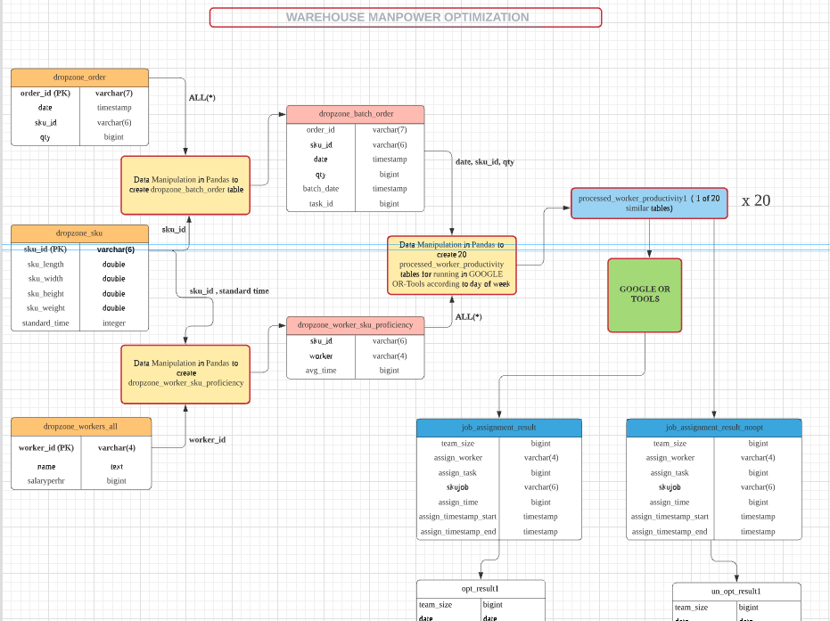
Continue next slide …

Slide 12
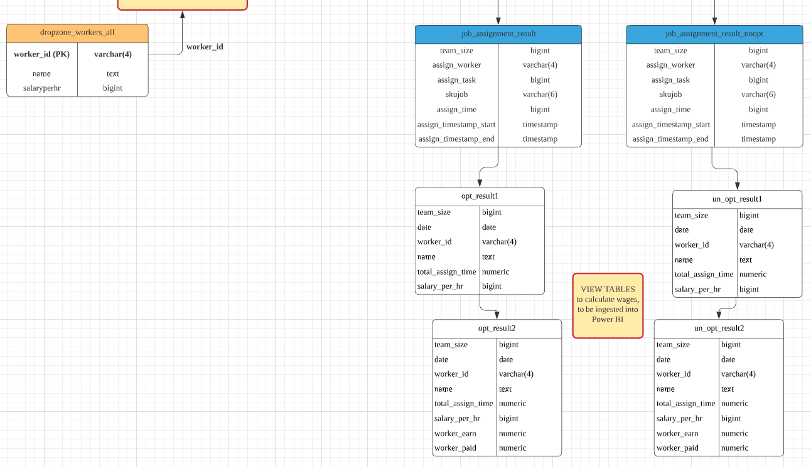


Continue from previous slide …
PostgreSQL Data is ingested into Power BI for visualization.

Slide 13
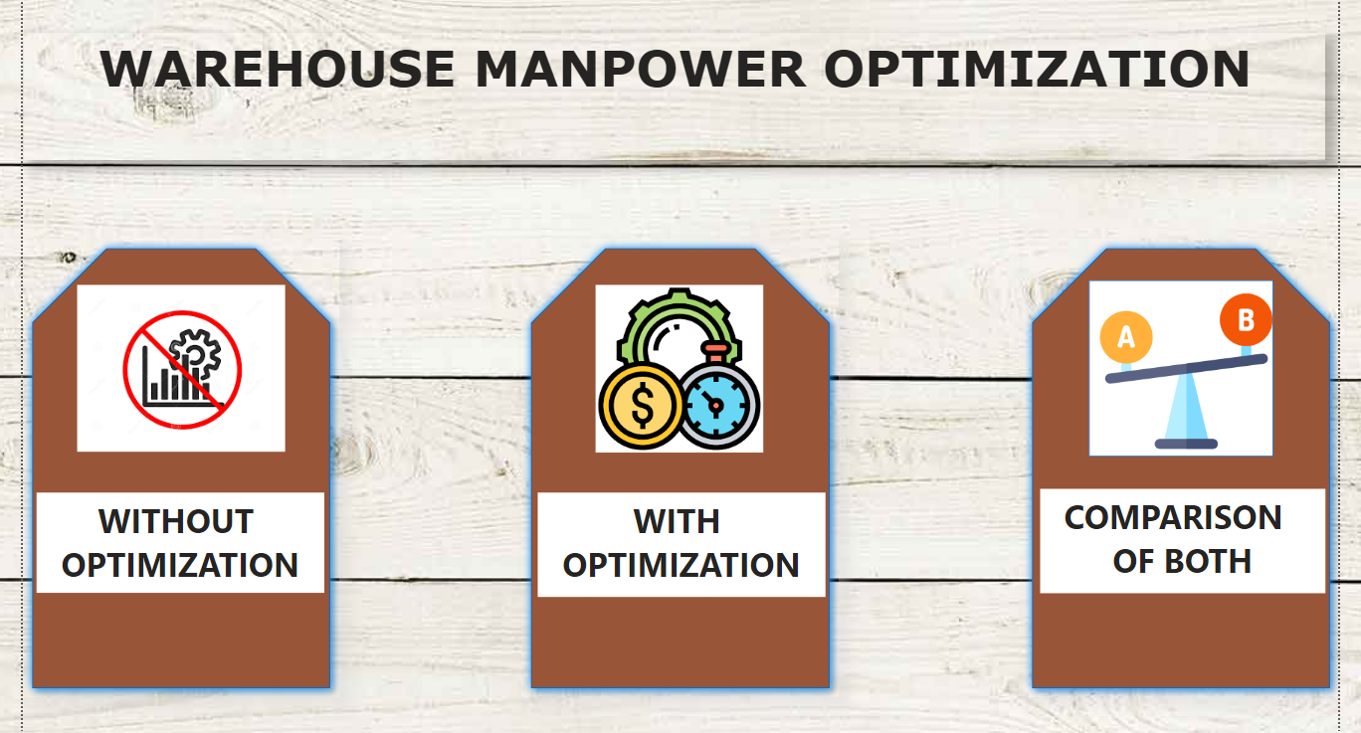

Slide 14
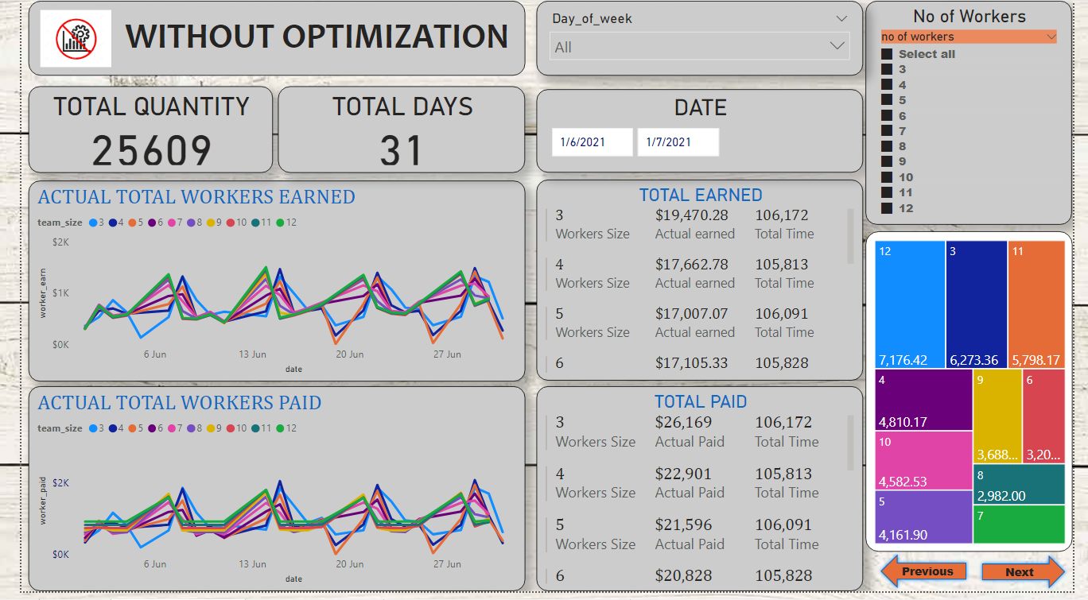

Slide 15
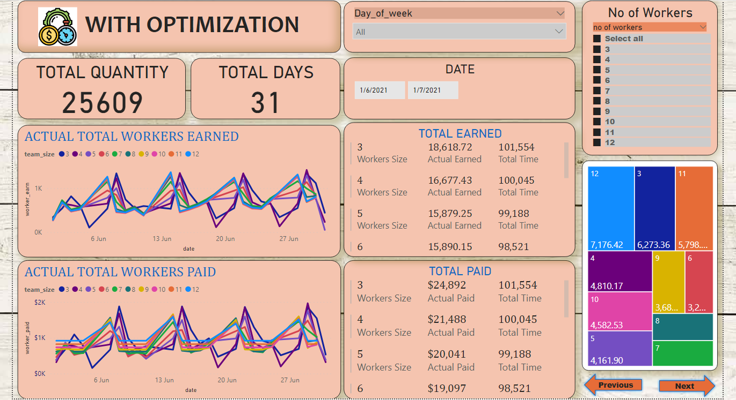

Slide 16
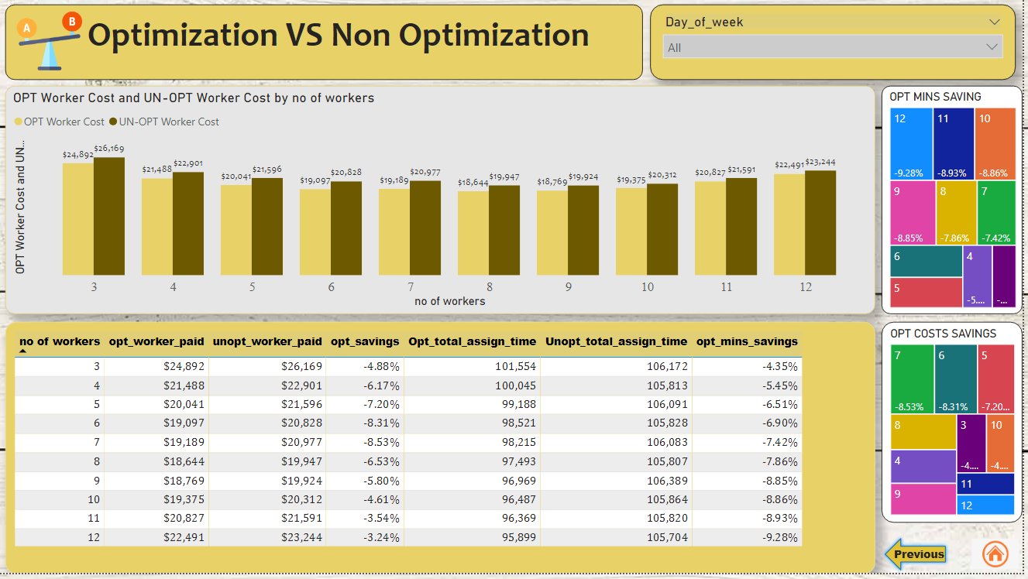

Slide 17
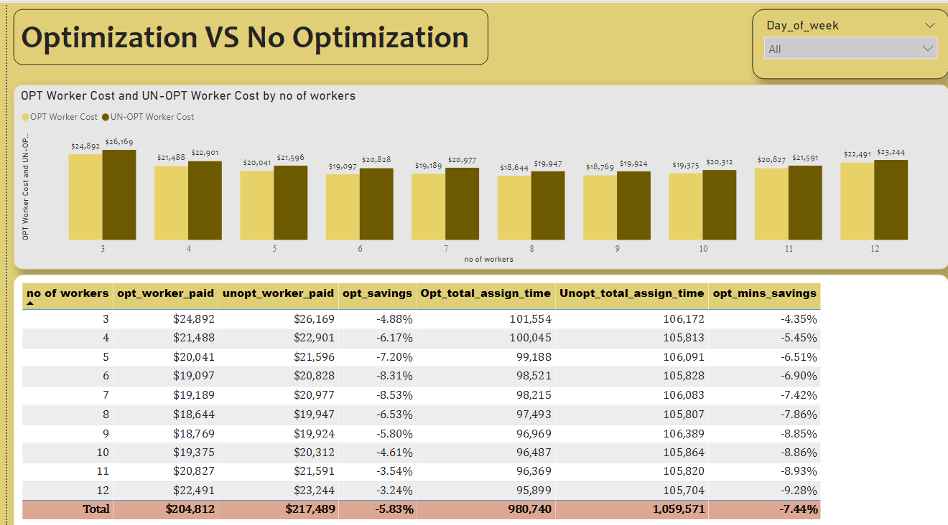
Monte Carlo simulation to determine optimal # of workers in operation
Optimal number of workers = 8
(lowest cost)
Savings in manhours, with optimization

Slide 18
Summary
1. Use Operation Research (OR) :
To optimize assignment of jobs to workers to achieve lowest manhours;
2. Use Monte Carlo Simulation :
To find optimal # of workers in the operation to achieve lowest manpower cost.
Too many workers results in idling manpower
Too few workers results in excessive overtime cost

Slide 19


